Slide 1
Desarrollo de Aplicaciones Web

Slide 2
Flexbox and Responsive Design

Slide 3
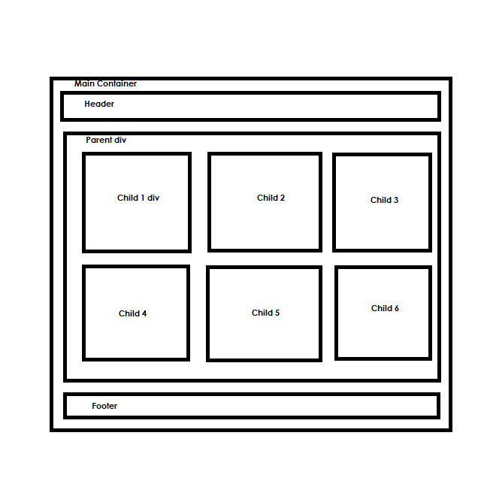
Flexbox Layout
The Flexible Box Module, usually referred to as flexbox, was designed as a method to offer space distribution between items with powerful alignment capabilities.
Aims to provide a more efficient way to layout , align, and distribute space among items in a container, even when their size is unknown, and/or Dynamic (this the Word “flex”).
The main idea behind flex layout is to give the container the ability to alter its item’s width/height (and order) to best fill the available space.
A flex container expands items to fill available free space or shrinks them to prevent overflow.

Slide 4
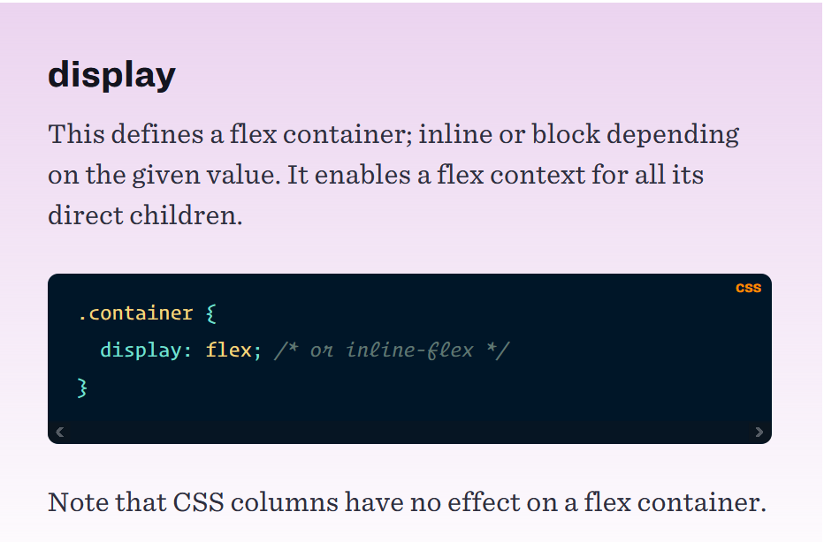
Properties for the Parent (flex container)

Slide 5
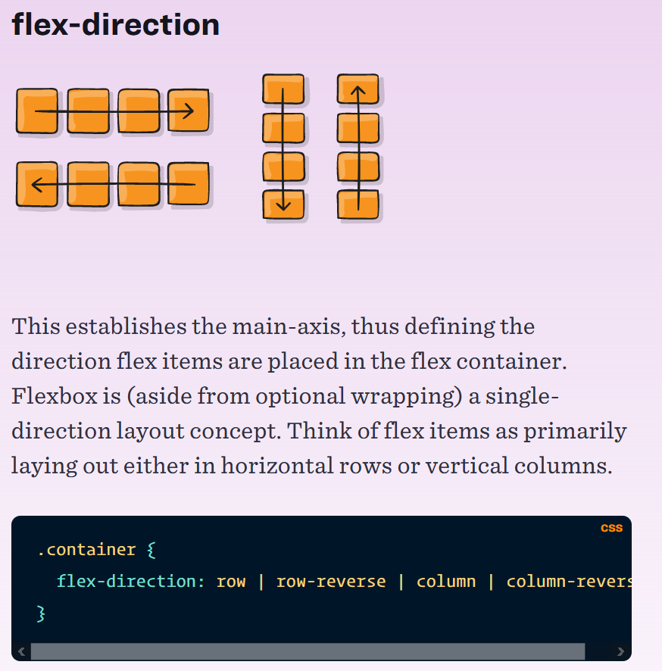
row (default): left to right in ltr; right to left in rtl
row-reverse: right to left in ltr; left to right in rtl
column: same as row but top to bottom
column-reverse: same as row-reverse but bottom to top

Slide 6
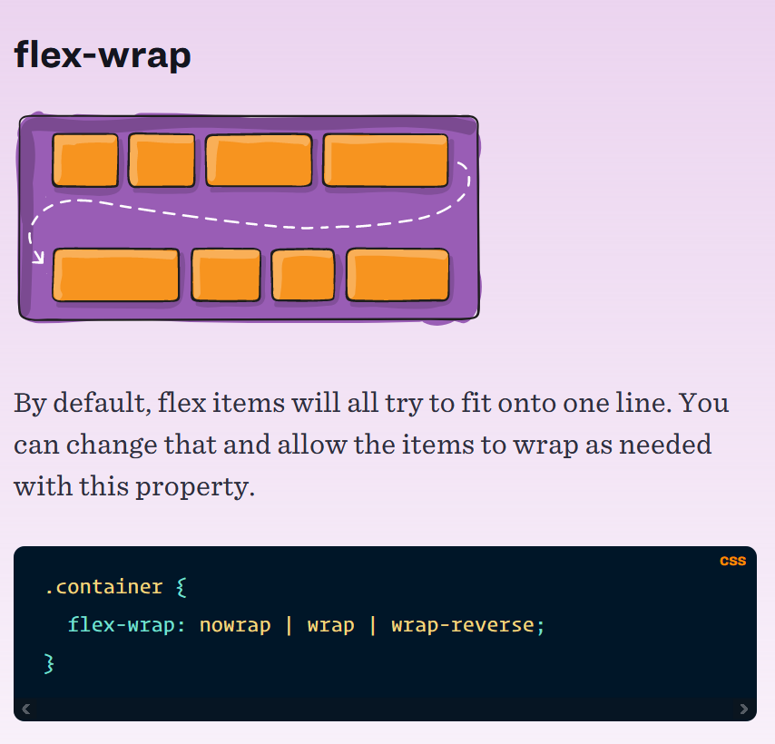
nowrap (default): all flex items will be on one line
wrap: flex items will wrap onto multiple lines, from top to bottom.
wrap-reverse: flex items will wrap onto multiple lines from bottom to top.

Slide 7
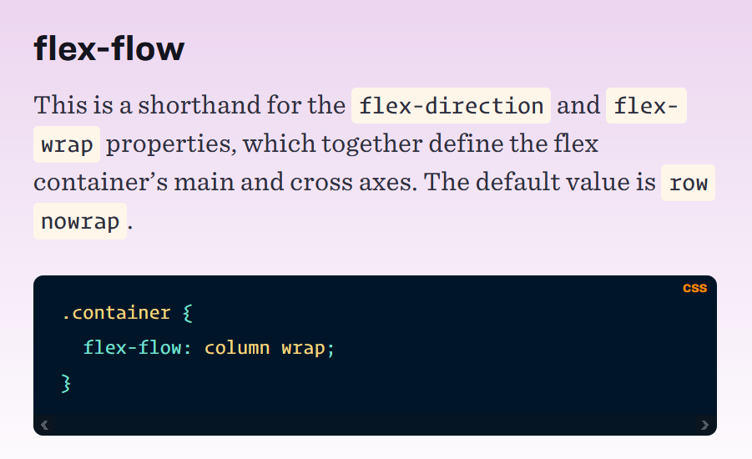
=
.container {
flex-direction: column;
flex-wrap: wrap;
}
.container {
flex-flow: column wrap;
}

Slide 8
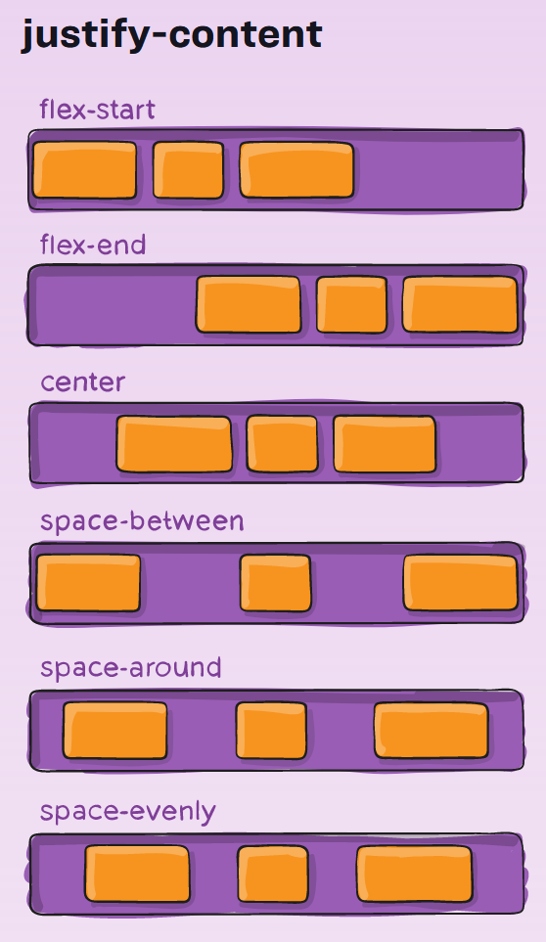
flex-start (default): items are packed toward the start of the flex-direction.
flex-end: items are packed toward the end of the flex-direction.
start: items are packed toward the start of the writing-mode direction.
end: items are packed toward the end of the writing-mode direction.
left: items are packed toward left edge of the container, unless that doesn’t make sense with the flex-direction, then it behaves like start.
right: items are packed toward right edge of the container, unless that doesn’t make sense with the flex-direction, then it behaves like start.
center: items are centered along the line
space-between: items are evenly distributed in the line; first item is on the start line, last item on the end line
space-around: items are evenly distributed in the line with equal space around them. Note that visually the spaces aren’t equal, since all the items have equal space on both sides. The first item will have one unit of space against the container edge, but two units of space between the next item because that next item has its own spacing that applies.
space-evenly: items are distributed so that the spacing between any two items (and the space to the edges) is equal.

Slide 9
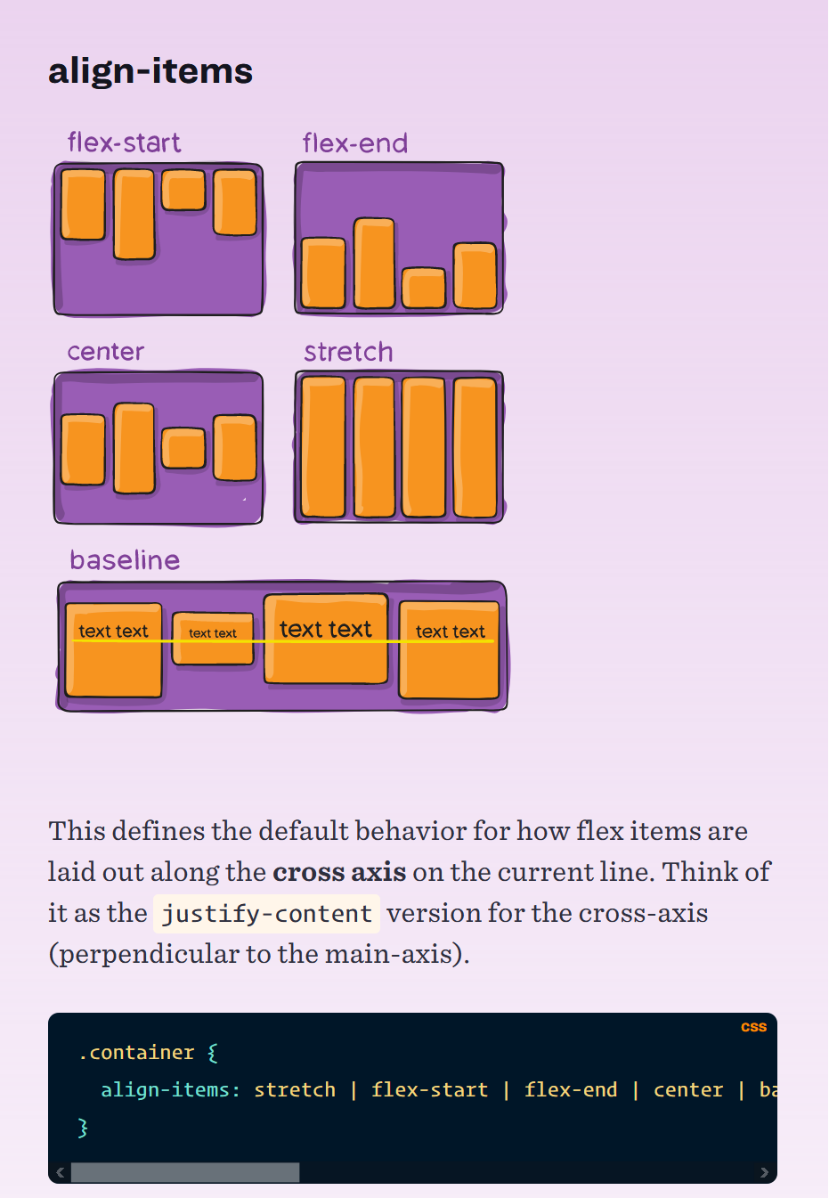
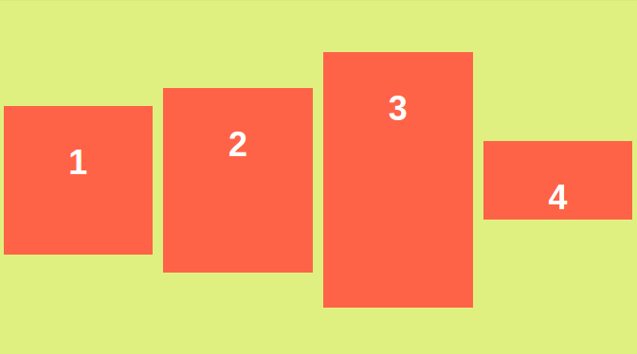
stretch (default): stretch to fill the container (still respect min-width/max-width)
flex-start : items are placed at the start of the cross axis. The difference between these is subtle, and is about respecting the flex-direction rules or the writing-mode rules.
flex-end : items are placed at the end of the cross axis. The difference again is subtle and is about respecting flex-direction rules vs. writing-mode rules.
center: items are centered in the cross-axis
baseline: items are aligned such as their baselines align
Align-items: center

Slide 10
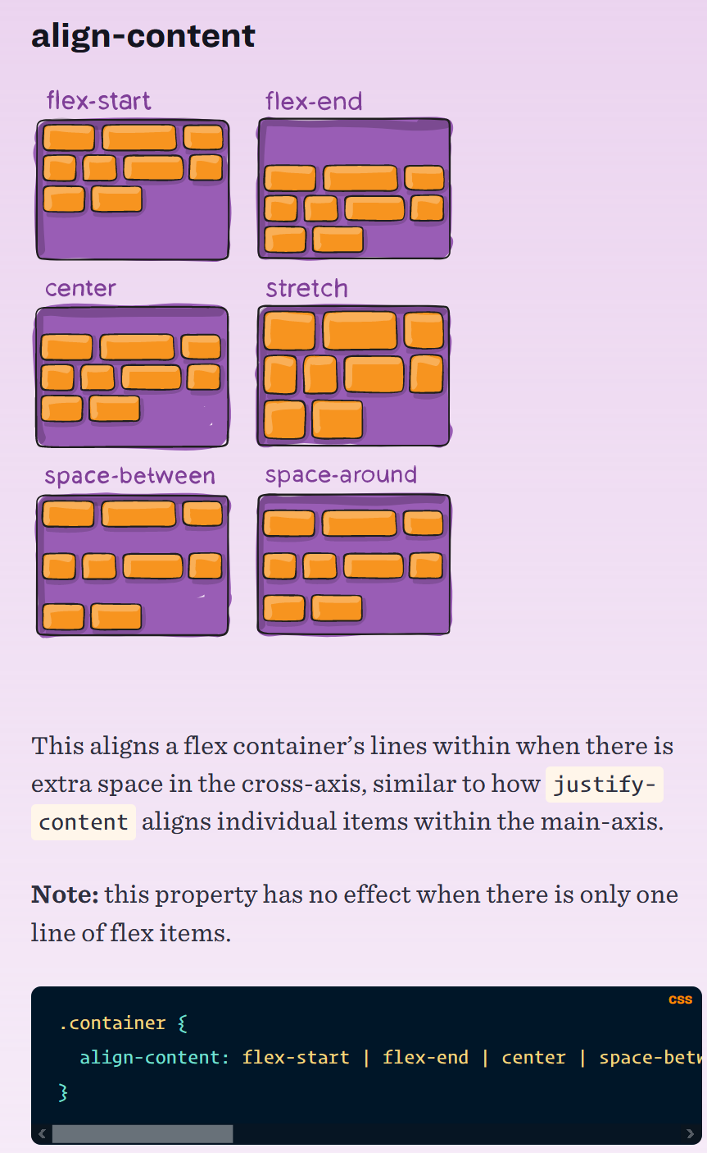
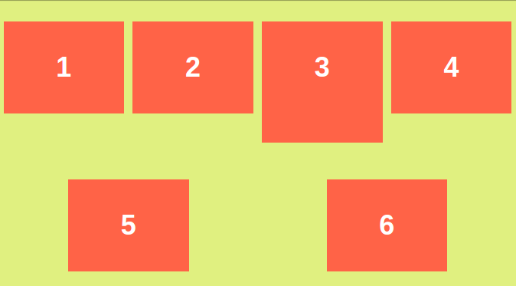
flex-start : items packed to the start of the container. The (more supported) flex-start honors the flex-direction while start honors the writing-mode direction.
flex-end: items packed to the end of the container. The (more support) flex-end honors the flex-direction while end honors the writing-mode direction.
center: items centered in the container
space-between: items evenly distributed; the first line is at the start of the container while the last one is at the end
space-around: items evenly distributed with equal space around each line
space-evenly: items are evenly distributed with equal space around them
stretch (default): lines stretch to take up the remaining space
Align-content: space-around

Slide 11
Properties for the Children (flex items)

Slide 12
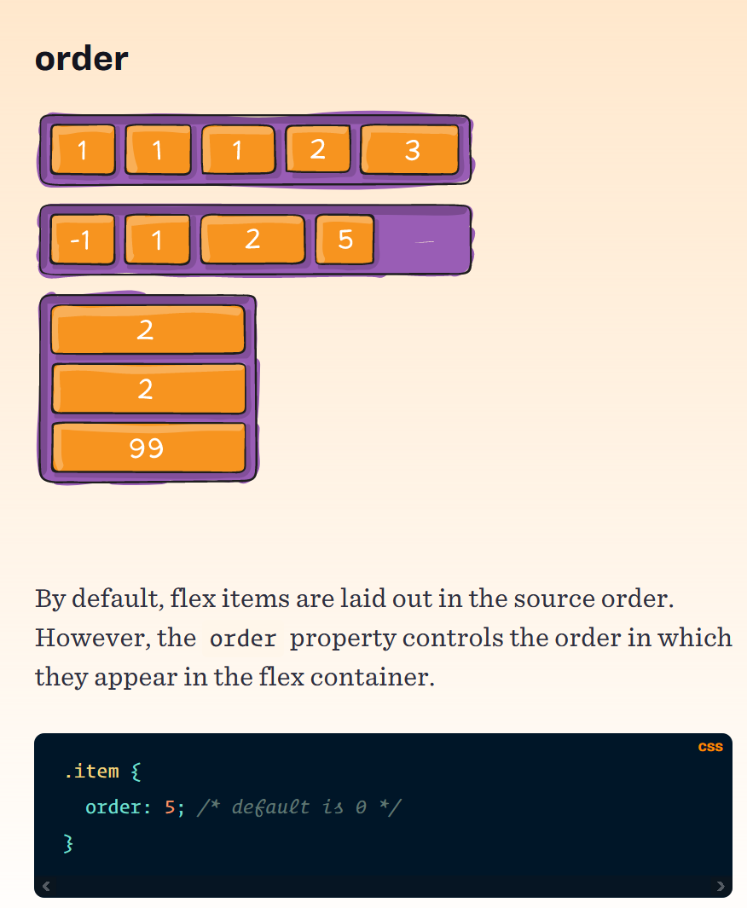

Slide 13
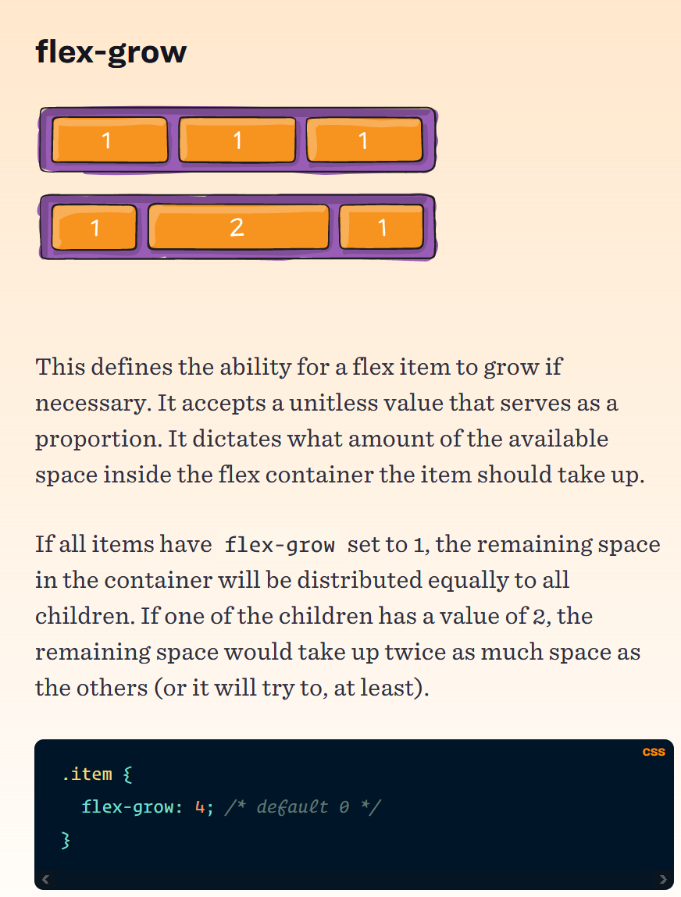

Slide 14
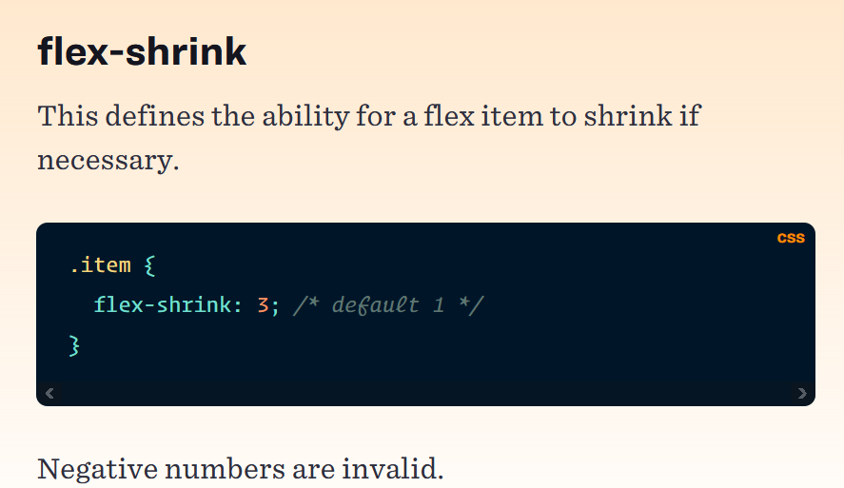

Slide 15
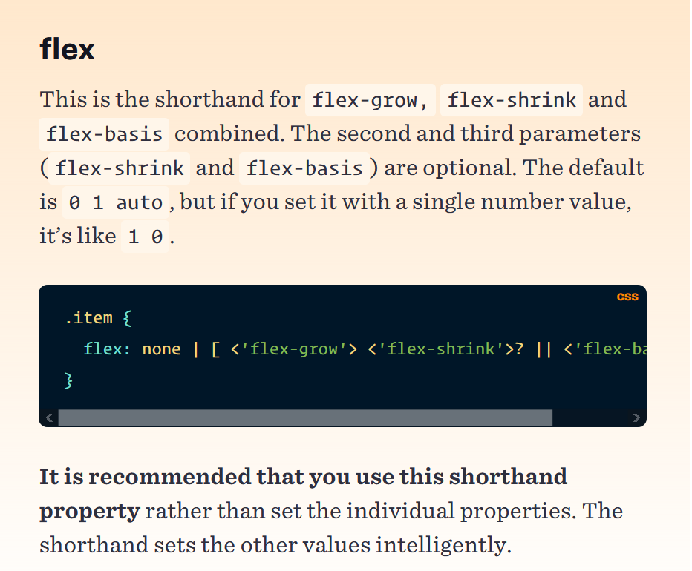

Slide 16
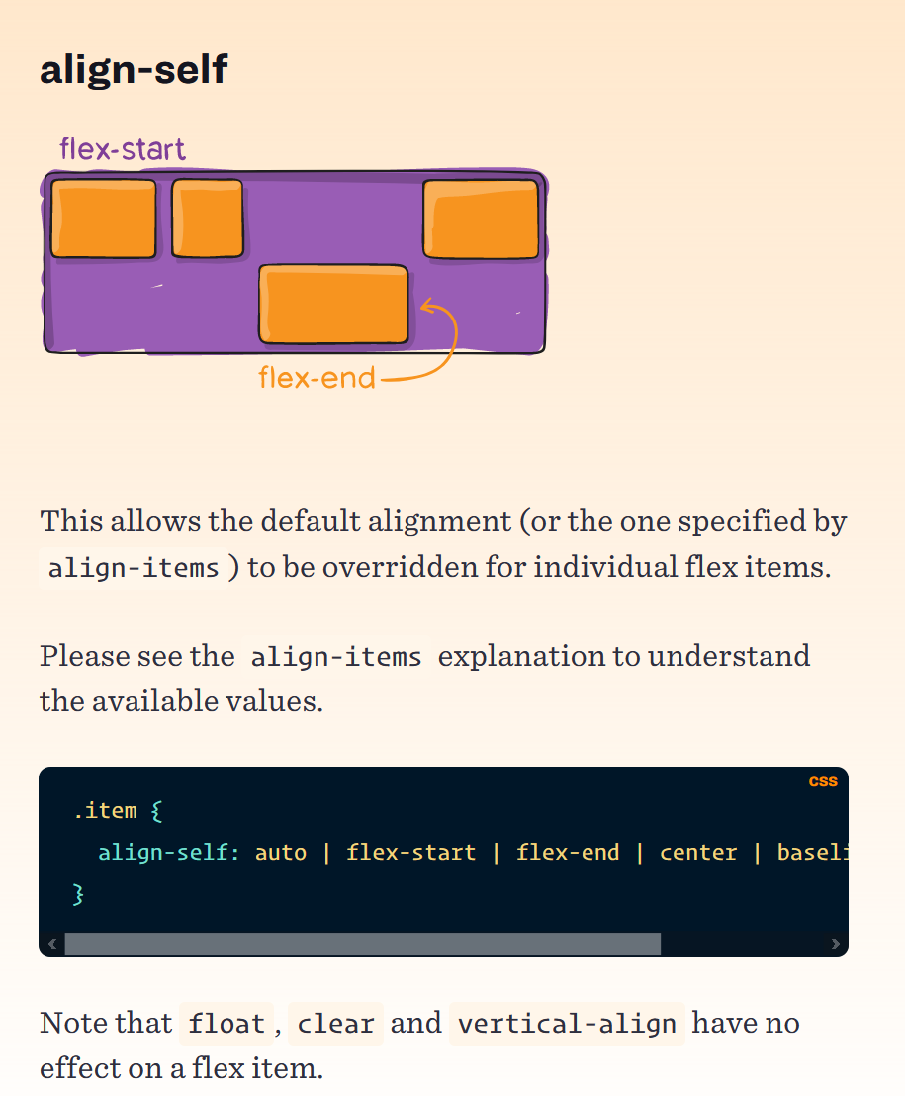

Slide 17
Ejemplo https://codepen.io/Jorge-Flores/pen/BajJvzJ?editors=1100

Slide 18
Ejercicio – 20 min
https://flexboxfroggy.com/

Slide 19
MediaQueries
Media queries are useful when you want to modify your site or app depending on a device’s general type (such as print vs screen).
A media query is composed of an optional media type and any number of media feature expressions.
Multiple queries can be combined in various ways by using logical operators.
Media queries are case insensitive.

Slide 20
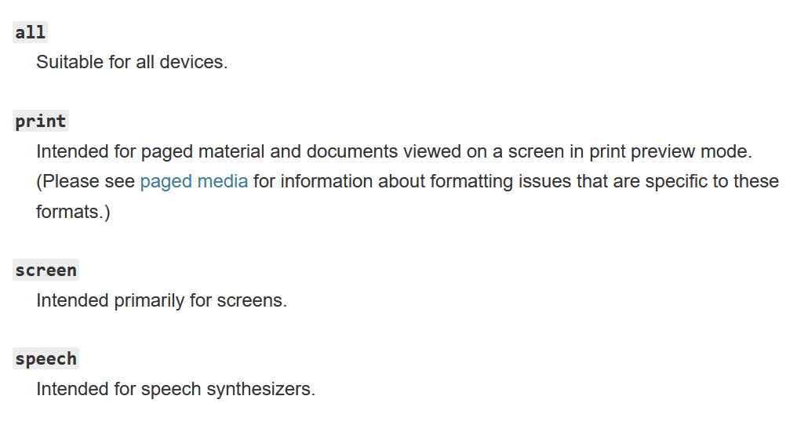
Syntax
[media type] + (media feature )*
Media Types
Describe the general category of a device. Except when using the not or only logical operators, the media type is optional and the all type will be implied.

Slide 21
Targeting media types

Slide 22
Media Features
Describe specific characteristics of the user agent, output device or environment. Media features test for their presence or value, and are entirely optional.
Each media feature must be surrounded by parentheses.
https://developer.mozilla.org/en-US/docs/Web/CSS/Media_Queries/Using_media_queries
Logical operators
AND – Combine multiple media features together into a single media query.
NOT – Negate a media query, returning true if the query would otherwise return false.
ONLY – Apply a style only if the entire query matches, and is useful for preventing older browsers from applying selected styles.
, (COMMA) -- Useful to combine multiple media queries into a single rule.

Slide 23
Targeting media features
If you create a media feature query without specifying a value, the nested styles will be used as long as the feature's value is not zero. For example, this CSS will apply to any device with a color screen:

Slide 24
Creating complex media queries
Combining multiple types or features
@media ( min-width: 300px ) and ( orientation: landscape ) { …}
The “and” keyword combines a media feature with a media type. This example combines two media features to restrict styles to landscape-oriented devices with a width of at least 300 px.
@media screen and ( min-width: 300px ) and ( orientation: landscape ) { …}

Slide 25
Testing for multiple queries
You can use a comma-separated list to apply styles when the user’s device matches any one of various media types, features, or states. Example: The following rule will apply its styles if the user’s device has either a mínimum height of 680 px OR is a screen device in portait mode:
@media ( min-height: 680px ) , screen and ( orientation: portrait ) { …}

Slide 26
Recommended Querys
Mobile (Smartphone) max-width: 480px
Low Resolution Tablets and ipads max-width: 767px
Tablets Ipads portrait mode max-width:1024px
Desktops max-width:1280px
Huge size (Larger screen) max-width: 1281px and greater

Slide 27
<style>
/* Media Query for Mobile Devices */
@media (max-width: 480px) {
body {
background-color: red;
}
}
/* Media Query for low resolution Tablets, Ipads */
@media (min-width: 481px) and (max-width: 767px) {
body {
background-color: yellow;
}
}
/* Media Query for Tablets Ipads portrait mode */
@media (min-width: 768px) and (max-width: 1024px){
body {
background-color: blue;
}
}
/* Media Query for Laptops and Desktops */
@media (min-width: 1025px) and (max-width: 1280px){
body {
background-color: green;
}
}
/* Media Query for Large screens */
@media (min-width: 1281px) {
body {
background-color: white;
}
}
</style>

Slide 28
I . Design the page for a small screen
Start the process by viewing the web page at a small window size to simulate what it might look like on a mobile device. Adjust some of the CSS to fine tune how the page displays.
Make the font-size larger
Make the h1 font-size smaller
Increase the leading
Add a small amount of margin to the page edges
By designing for the small screen first we're using what is known as a mobile first approach. By doing this, we start with a basic design or lowest common denominator and then work on enhancing more sophisticated browsers with advanced features or layouts.
This ensures that we're designing an experience that will work for everyone. It also has the side effect of often helping us realize what content on our website is really important.

Slide 29
II . Finding your browser window size
In Chrome you can easily find out what size your browser window is by using the Web Inspector. Open the web inspector in Chrome and resize your browser window while watching the top right corner. The pixel dimensions should appear as you resize.

Slide 30
III . Introduce a new breakpoint
Start expanding your browser window width. Do this until you get to a point where the design no longer works. For example, the line length might become too long for the text to be easily readable. Or perhaps the page becomes wide enough that it no long makes sense for the images to display in a stack.
Record the width of the browser window at this point. This will be your first breakpoint. A breakpoint is simply a point at which we're defining that the design should change.
Create a new media query in your browser using the pixel dimension you recorded as the min-width media feature test. Within this breakpoint, change your CSS to do the following:
Change the background color (to help you see when the media query takes effect)
Adjust the font-size if necessary
Adjust the page margins
Make the photos display in two columns

Slide 31
IV .Create another breakpoint for large screens
Resize your browser window again to find another breakpoint. Add a new media query in your CSS and adjust the following rules:
Change the background color
Adjust the font-size if necessary
Adjust the page margins
Make the photos display in three columns
Add a max-width to the page to make sure the line length never gets too long

Slide 32
Tips
Don’t target specific devices or sizes!
Develop the site for mobile first using percentages or ems, not pixels.
Then try it in a larger viewport and note where it begins to fail.
Redesign the layout and add a CSS media query just to handle the broken parts.
Repeat the process until you reach the next breakpoint.
The ‘breakpoints’ “… your mobile design begins to break” means when your design cease to be usable or visually pleasing. Once you have a good working mobile site, without media queries, you can stop being concerned about specific sizes and simply add media queries that handle successively larger viewports.
Ejemplo codepen

